Slide 1

SOCIOLOGY
Power, Ethnicity, Class, Gender and Health
Exploring Health Inequity Through Social Categories and Power Dynamics
__________________________
Lubna Syed

Slide 2

Objectives
Examining the Concepts of Class, Ethnicity, Gender, Sexuality and Health
Understanding the Role of Social Determinants in Health Inequity
Exploring the Concept of Power in Society
Intersections Between Healthcare and Power in Society
Implications of Power Differentials in Healthcare for Clinical Practice

Slide 3
Examining the Concepts of Class, Ethnicity, Gender, Sexuality and Health

Slide 4
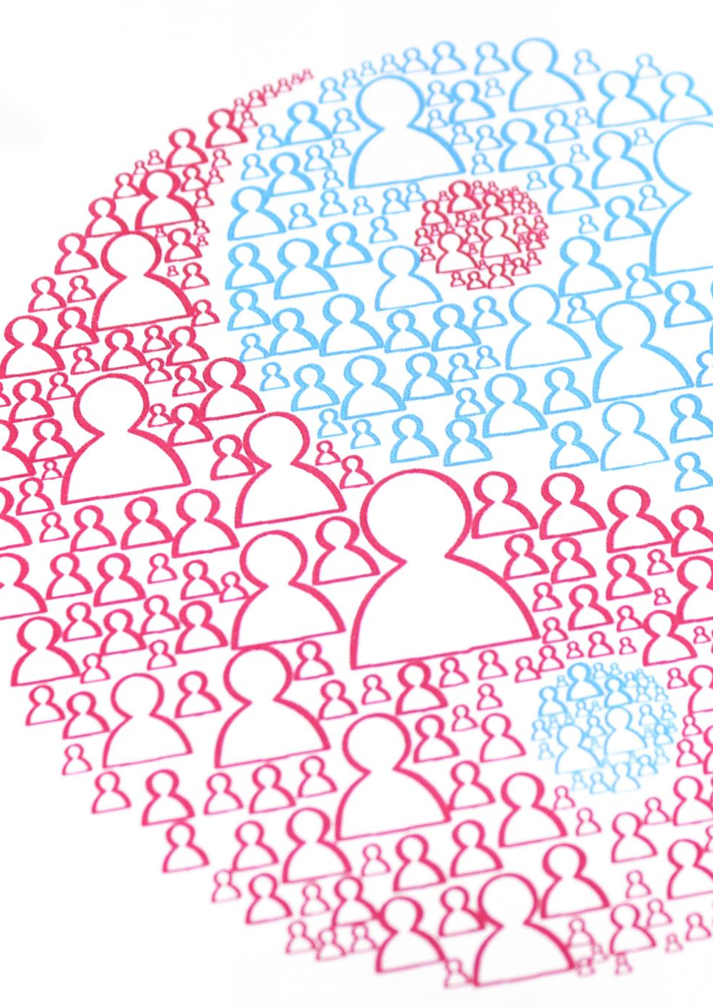
The Influence of Social Categories on Health Experiences
Access to Healthcare
  Social categories such as class, ethnicity, gender, and sexuality can impact access to healthcare services.
Exposure to Health Risks
  Social categories such as class, ethnicity, gender, and sexuality can impact exposure to health risks.
Social Support
  Social categories can impact social support, affecting the ability of individuals to cope with health challenges and access resources for their health.

Slide 5

Impact of Class on Health Outcomes
The Social Determinants of Health
  Social determinants of health, such as income, education, and living conditions, play a critical role in shaping health outcomes.
  The Impact of Income on Health
  Income is a key determinant of health.

Slide 6
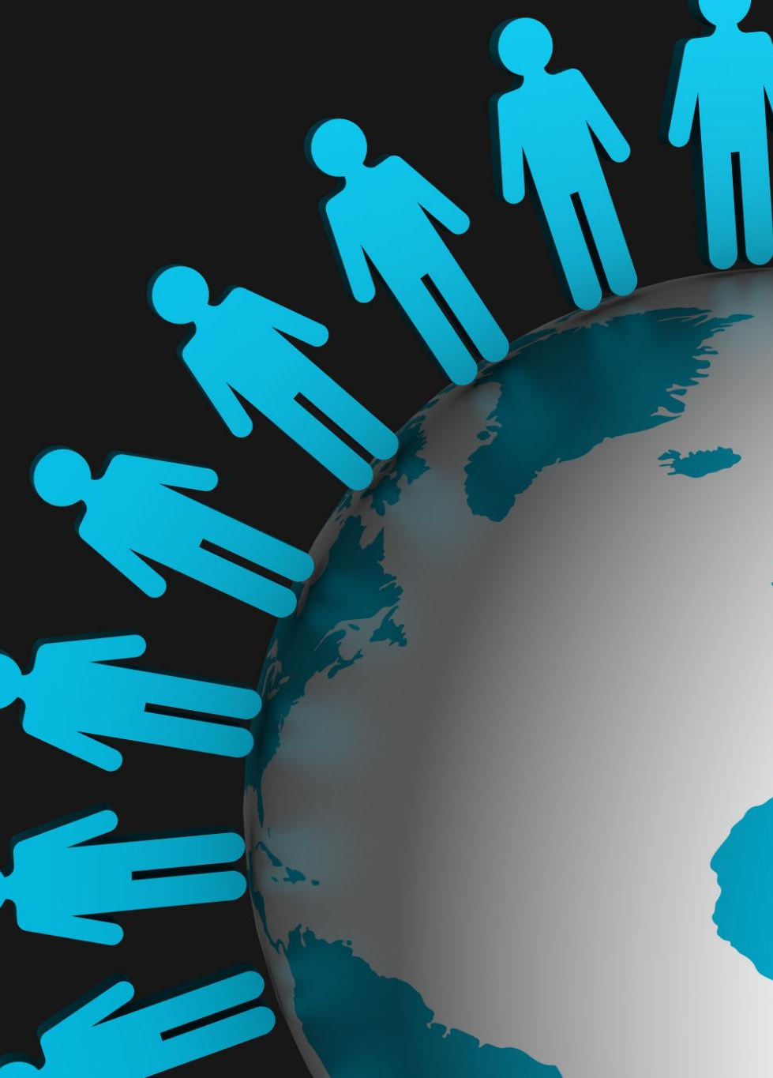
How Ethnicity, Gender, and Sexuality Shape Health
  Ethnicity, gender, and sexuality are social categories that interact with each other and with structural inequalities to shape health experiences and outcomes in unique ways.

Slide 7
Understanding the Role of Social Determinants in Health Inequity

Slide 8
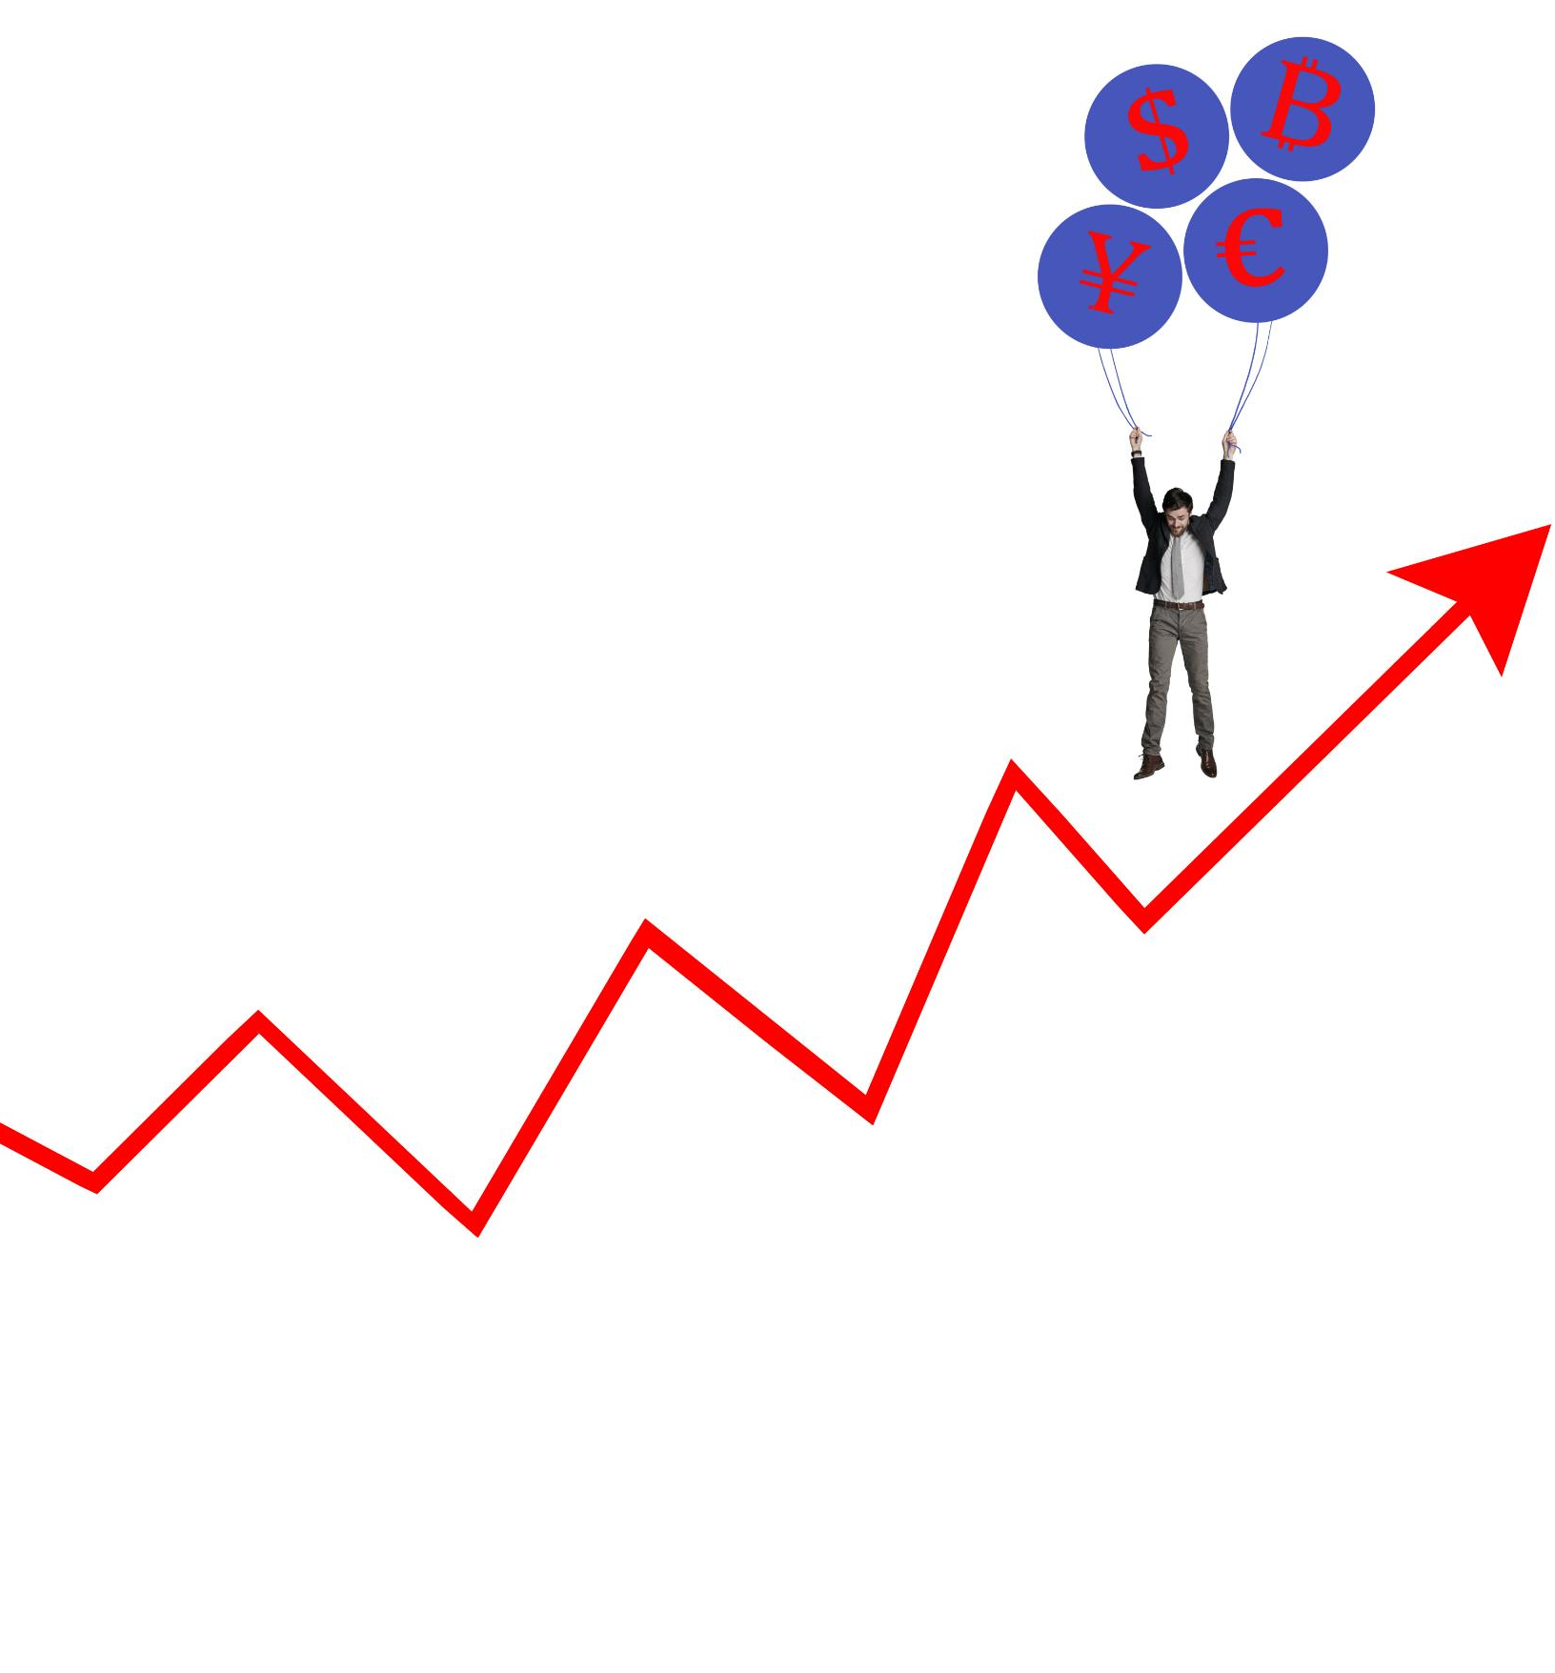
Unequal Distribution of Health Resources
  Social determinants such as income, education, and race can significantly impact access to health resources.

Slide 9

Barriers to Access to Care
Race
  Race can be a barrier to access to care due to factors such as implicit bias, lack of culturally responsive care, and discriminatory policies.
Ethnicity
  Ethnicity can influence access to care due to language barriers, cultural beliefs.
Geographic Location
  Geographic location can create barriers to access to care due to lack of healthcare facilities, transportation issues and rural/urban divide.

Slide 10
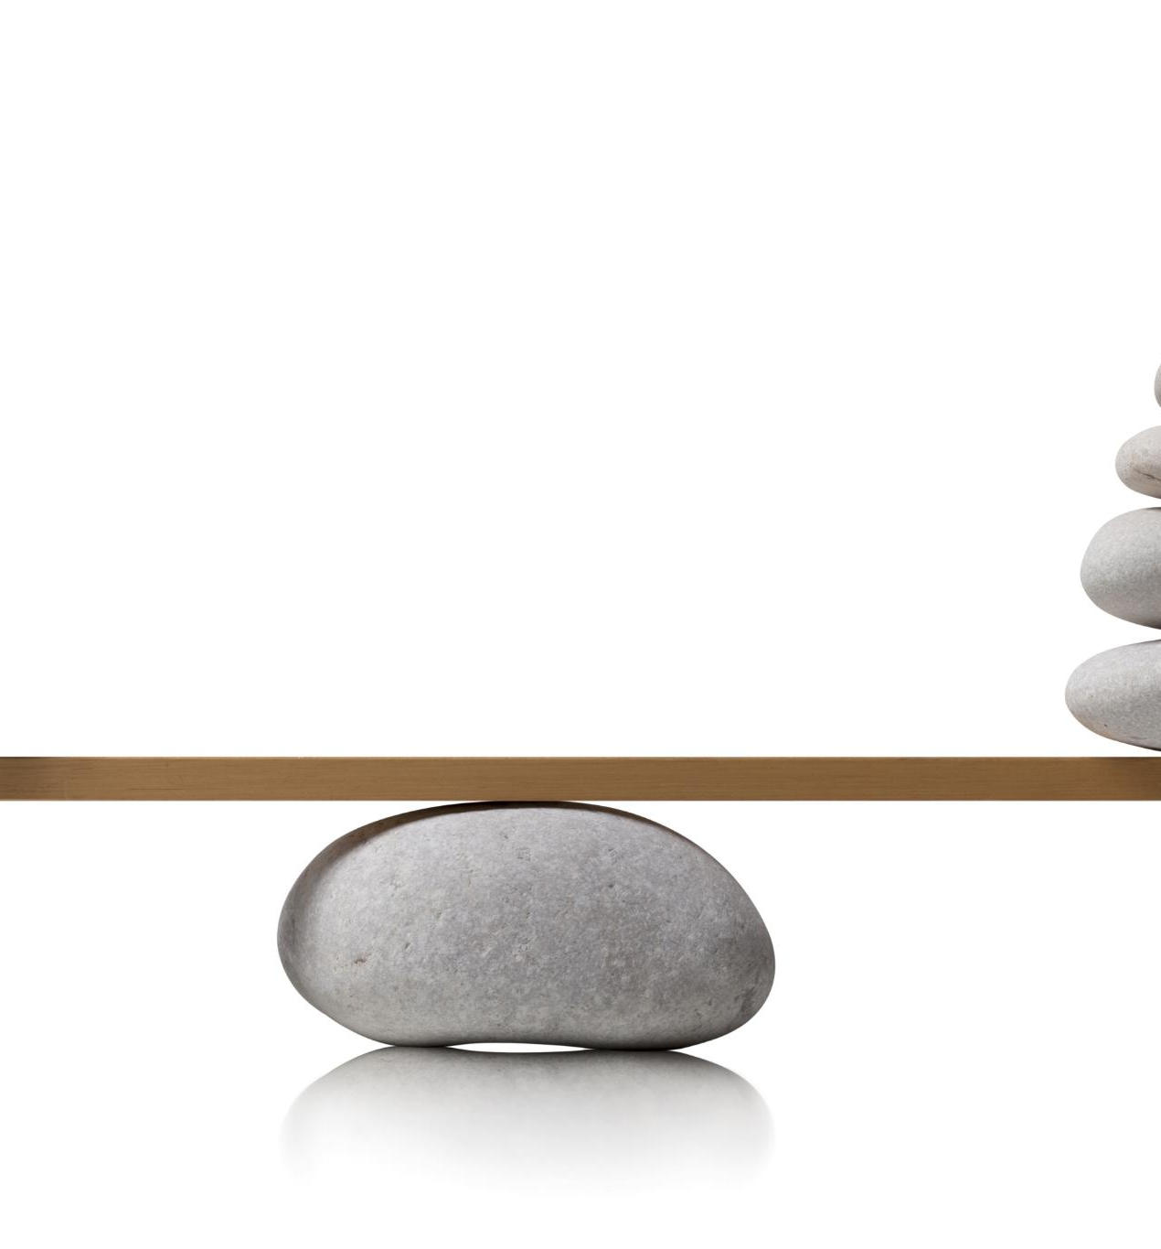
Social Determinants and Their Effects on Health Equity
Social Determinants
  Social Determinants are the conditions in which people are born, grow, live, work and age.
Health Inequity
  Health inequities are differences in health outcomes and access to care between different groups of people.

Slide 11
Exploring the Concept of Power in Society

Slide 12
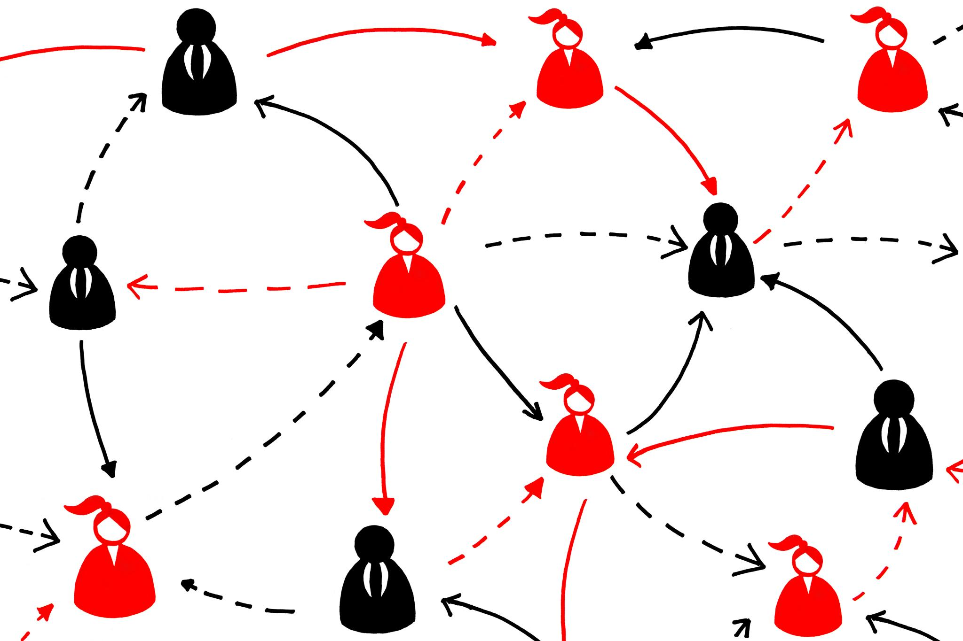
Defining Power in Sociological Terms
  Power is the ability to influence others and is shaped by social relations, norms, and institutions.

Slide 13
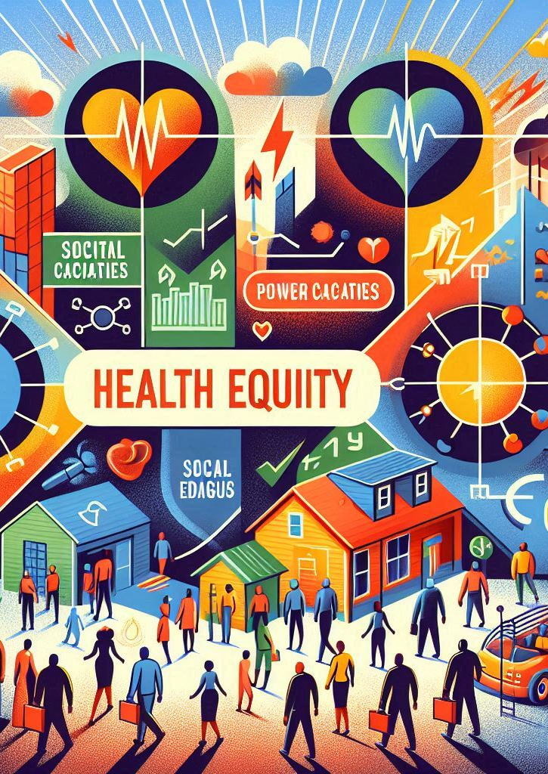
Manifestations of Power in Societal Institutions
Power in Government Institutions
  Power is often concentrated in government institutions, which can perpetuate power imbalances and contribute to health inequity.
Power in Educational Institutions
  Educational institutions can perpetuate power imbalances and contribute to health inequity by privileging certain groups over others based on factors such as race, ethnicity, and socio-economic status.
Power in Healthcare System
  The healthcare system can continue power imbalances and contribute to health inequity by providing unequal access to healthcare services based on factors such as race, ethnicity, and socio-economic status.

Slide 14

Power Dynamics Within the Healthcare System
  The power dynamics within the healthcare system can significantly impact access to care, clinical decision-making, and patient-provider interactions, leading to disparities in health outcomes.

Slide 15
Intersections Between
Healthcare and Power in Society

Slide 16

Healthcare Systems and Societal Power Dynamics
  Societal power dynamics can influence the healthcare system, resulting in disparities in access to care, quality of care, and health outcomes. Political and economic factors can affect healthcare policies and funding, which can lead to systemic inequalities.

Slide 17
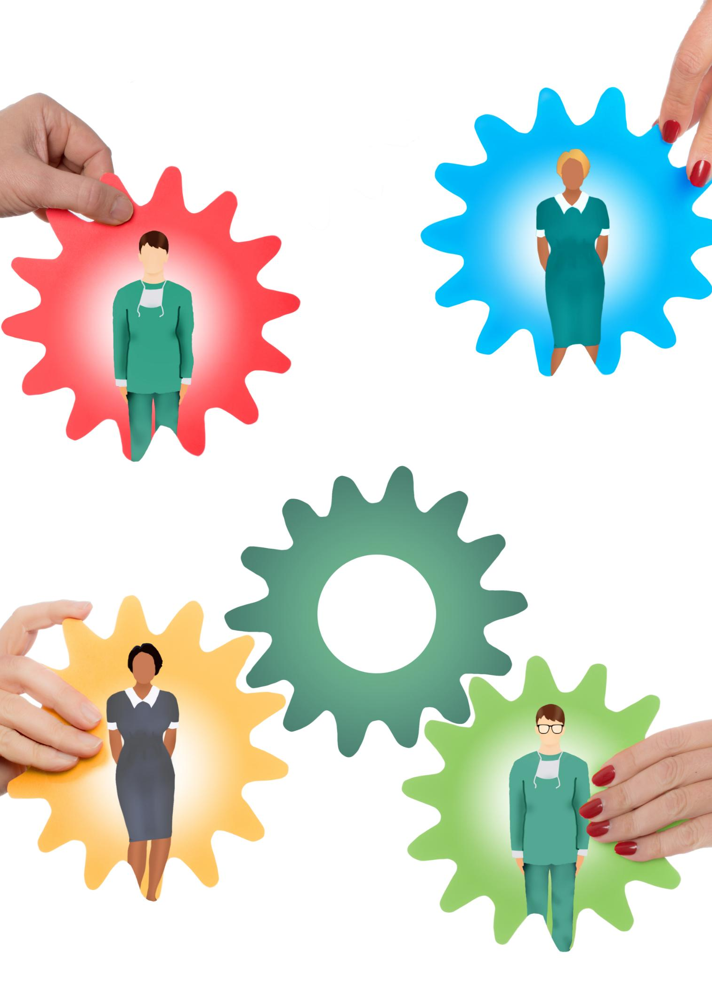
How Power Operates Within Healthcare Systems
Power Dynamics in Clinical Encounters
  Power differentials can influence the quality of patient-provider relationships and care delivery in clinical encounters.
  Healthcare Access
  Power imbalances can also affect healthcare access and utilization, particularly among marginalized communities.
  Patient Outcomes
  Power dynamics within healthcare systems can ultimately impact patient outcomes, including morbidity and mortality rates.

Slide 18
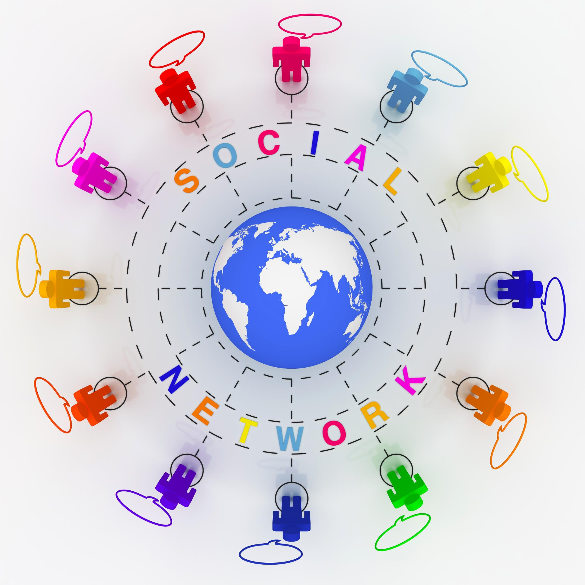
Power Imbalances and Healthcare Delivery
Impact on Clinical Decision-making
  Power imbalances between providers and patients can impact clinical decision-making, leading to suboptimal treatment plans and poor health outcomes.
Patient-Provider Interactions
  Power imbalances between providers and patients can negatively impact patient-provider interactions, leading to a lack of trust, poor communication, and ultimately, poor health outcomes.

Slide 19
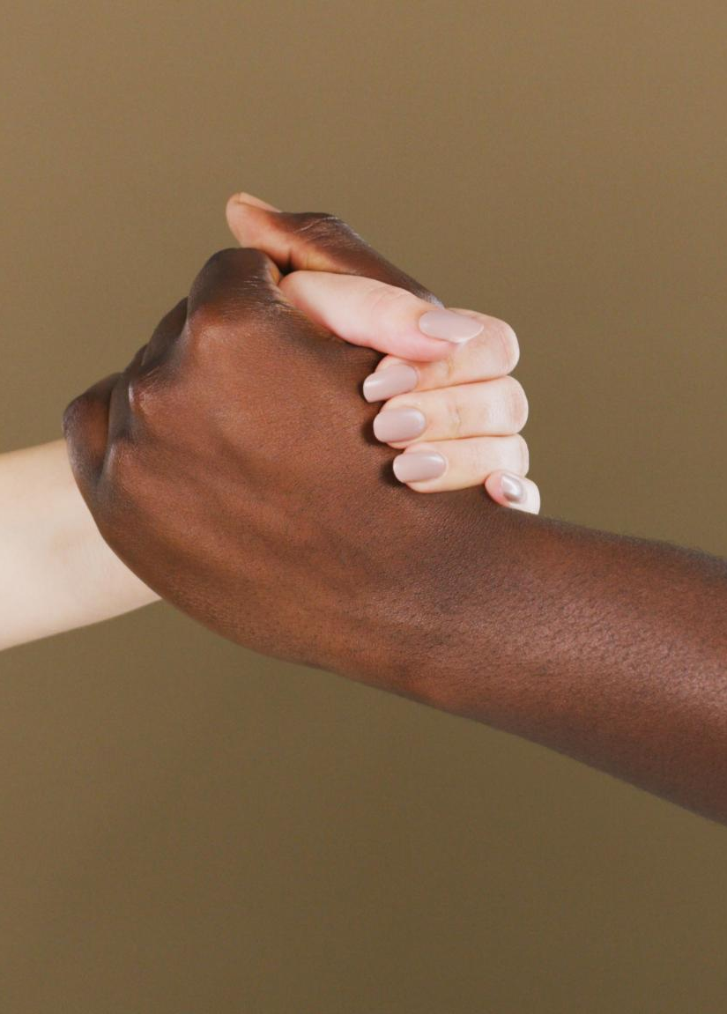
Impact on Marginalized Groups
Healthcare Disparities
  Marginalized groups, such as racial and ethnic minorities, LGBTQ+ individuals, and low-income populations, experience healthcare disparities due to power imbalances in the healthcare system.
Social Determinants of Health
  Social determinants of health, such as poverty, discrimination, and lack of access to education and healthcare, contribute to healthcare disparities among marginalized groups.

Slide 20
Implications of Power Differentials in Healthcare for Clinical Practice

Slide 21
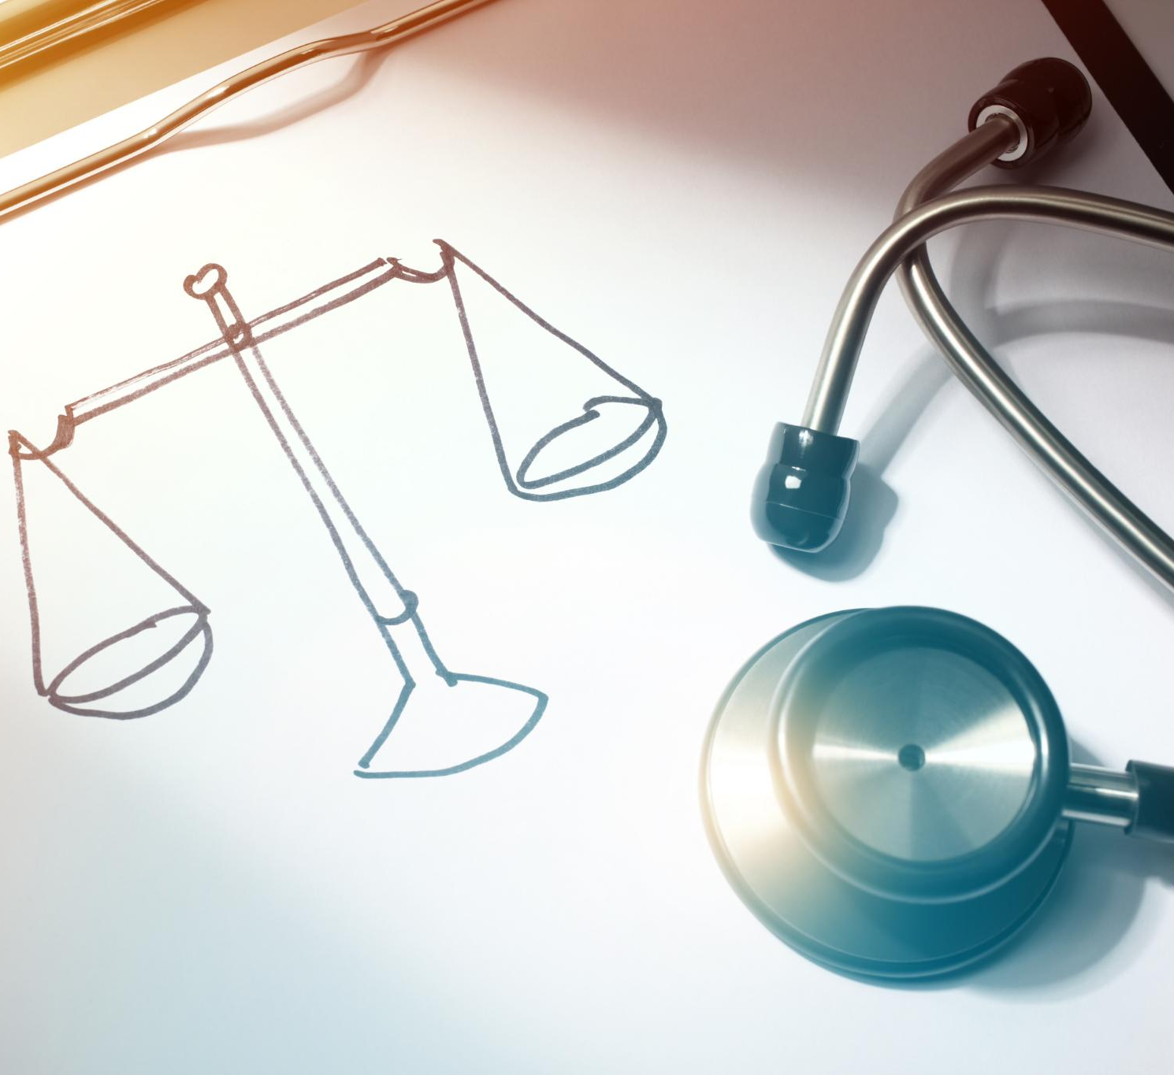
Power Differentials Between Providers and Patients
Impact on Clinical Decision-Making
  Power differentials can impact clinical decision-making by influencing the information that is shared, the treatment options presented, and the care provided to the patient.
Patient-Provider Interactions
  Power differentials can impact patient-provider interactions by affecting communication, trust, and patient satisfaction.
Impact on Health Outcomes
  Power differentials can impact health outcomes by influencing the quality of care received, adherence to treatment, and patient outcomes.

Slide 22

Implications for Healthcare Providers
  Power differentials can negatively impact healthcare providers, leading to burnout and other negative consequences.

Slide 23
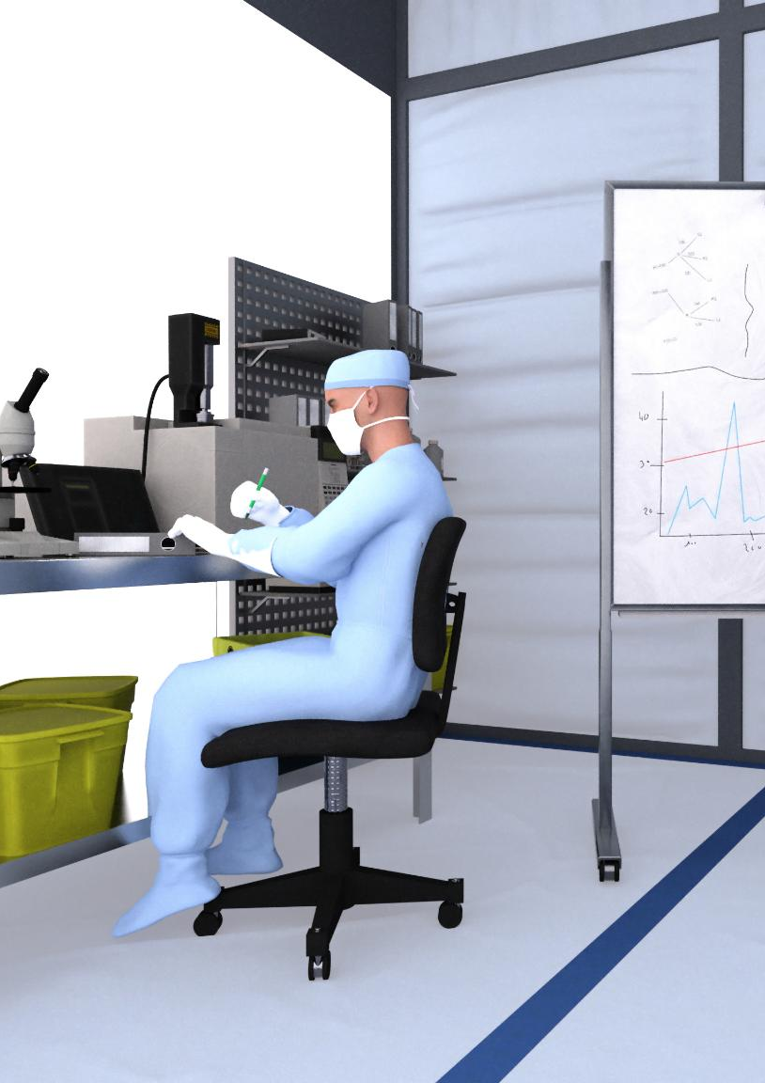
Influence on Clinical Interactions and Decision-Making
  Power differentials between providers and patients can significantly impact the quality of communication, trust, and shared decision-making, leading to suboptimal outcomes for patients.

Slide 24

Strategies for Equitable Care Practices
Understanding Power Differentials
  Promoting equitable care practices requires understanding and addressing power differentials in the healthcare system.
  Cultural Humility
  Cultural humility is the practice of self-reflection and self-critique by healthcare providers to understand and respect patients' cultural beliefs and values.
  Patient-Centred Care
  Patient-centred care is an approach to healthcare that prioritizes the needs and preferences of the patient.
  Advocacy for Marginalized Populations
  Promoting equitable care practices also involves advocacy for marginalized populations, such as racial and ethnic minorities, LGBTQ+ individuals, and individuals with low socioeconomic status.

Slide 25


Slide 26


